Slide 1

EMDR BASIC TRAINING
DAY 3
Nikolaus Johnson, MS, LPC, RPT, EMDR Consultant

Slide 2
SCHEDULE FOR TODAY
Today we visit the 8 phases of EMDR through the lens of children.
8:30 am -10:30 am, Reviewing Phases 1 and 2; How has it been going?
10:30 am -10:45 am, Break
10:45 am -12:15 pm, Discuss remaining phases and demonstrate
12:15 pm -12:45 pm, Break
12:45 pm - 2:15 pm, Discuss Phase 3 in detail and practice
2:15 pm - 2:30 pm, Break
2:30 pm – 5:30 pm, Discuss Phase 4 in detail and practice

Slide 3
SCHEDULE FOR ENTIRE TRAINING
There are 6 days of training and an additional 10 hours of consultation.
W1 Th: Review of entire model Phase 1
W1 F: Phase 2
W2 Th: Phases 3 and 4
W2 F: Phases 5,6,7,8
Consultation dates
W3 Th:
W3 F:

Slide 4

What is EMDR?
Eye Movement Desensitization Reprocessing
Three-Pronged Approach
    Past
    Present triggers
    Future
Grounded in the AIP Model
8 Phase Model
EMDRIA.org, 2022

Slide 5
The 8 Phases of EMDR
5
1
1
(Phase 1) Client History Phase
(Phase 5) Installation Phase
4
2
2
(Phase 2) Preparation Phase
6
5
(Phase 6) Body Scan Phase
7
3
(Phase 3) Assessment Phase
6
(Phase 7) Closure Phase
8
4
(Phase 4) Desensitization Phase
(Phase 8) Reevaluation Phase
EMDRIA.org, 2022

Slide 6

How has it gone this last month?

Slide 7

Phase 3 and 4 Demonstration

Slide 8
Phase 3: Assessment
The objective of this phase is to set up an EMDR target for reprocessing.
Today and for the next few months we will be going by the script.
The purpose of these questions is to activate the mid brain enough to have processing.
Using the script with clients has significant results.
Additionally, clients typically don’t mind the script.
EMDRIA.org, 2022

Slide 9
Image
When you think of the event, what image is the worst part of it for you?
Once they answer, ask for additional sensory information.
      Five senses
If they cannot identify a “worst part”, use the film reel technique.
Write everything down in their words!

Slide 10
Negative Cognition
When you think about [image, in detail], what words feel true about you?
We are looking for “I am” statements (i.e. “I am bad”, “I am helpless”).
When people answer in the past tense (i.e. “I was helpless”), ask them what it means about them right now.
Oftentimes, clients will start with a “cover story”.
If this is the case, you can ask “If you are stuck, what is true about you now?”.

Slide 11
Positive Cognitions
Next ask the client, “When you think about the words [use negative cognition], what would you rather believe about yourself instead?” (i.e. “I am good”, “I am powerful”.

Slide 12

Validity of Cognition
“When you think of the words [positive cognition], how true do they feel now, on the scale of 1, not at all true, to 7, completely true?”

Slide 13

Emotions
“When you think of the [image with detail] along with the [negative cognition], what emotions do you feel right now?”

Slide 14
Subjective Unit of Distress SUDS

Slide 15
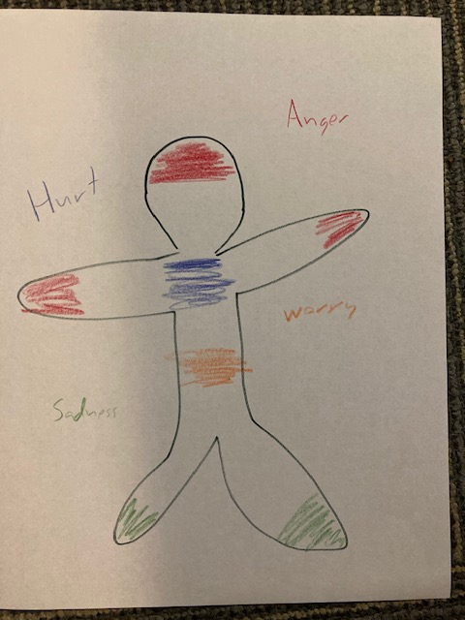
Body Sensations
“When you think of the [image with detail] along with the [negative cognition], what body sensations do you feel right now?”

Slide 16
Transition to Phase 4
Review the image, NC, emotion, body sensation
Remind client of the stop sign
Gonzalas & Mosquera, 2012

Slide 17
Let’s Practice Phase 3

Slide 18
Case Studies
In your book there are 3 case studies.
Match up with someone
Fill out the EMDR worksheet roleplaying this client.
Steinberg and Schnall, 2001

Slide 19
How’d it go?

Slide 20
Common Dissociative Symptoms
You dislike your client
Client presents with flat or incongruent affect
Client argues with him or herself
Client takes a long time in answering questions
Client mood changes rapidly
Client denies saying something the previous session
No memory or few memories from childhood
No or few body sensations
Passing out for no reason
Headaches in odd places of the head
Trouble swallowing
Visual or audible hallucinations

Slide 21
Phase 4: Desensitization
Go with that!
This is the part of the EMDR many refer to as EMDR when they ask, “When are we going to do EMDR?” All phases are EMDR.
Channels
  The back of the hand analogy
  When to not use eye movements
BLS/DAS
  Try eye movements first
  When to not use eye movements

Slide 22
Phase 4: Desensitization
Types of processing
  Visual
  Somatic
  Emotional

Slide 23
Phase 4: Desensitization
What do you do during reprocessing?
            Maintain connection with the client through co-regulation.
    Stay out of the way!
  Staying out of the way can be incredibly hard for talk therapists.
Adjust length of sets and speed based on client needs.

Slide 24
Phase 4: Desensitization
Safety
Choice
Responsibility
Handling abreactions
It is ideal to ride the line in the window of tolerance during processing.

Slide 25
Let’s Practice Phases 3 and 4

Slide 26
How’d it go?

Slide 27
See you tomorrow morning!

Slide 28

ANY QUESTIONS?
THANKS FOR LISTENING!

Slide 29
References
EMDRIA.org
Go With That Magazine, Fall 2020, Vol 25, Issue 3. EMDR & Racial Trauma
Guidelines for Virtual EMDR Therapy (Spring 2020).
Gonzalas & Mosquera (2012). EMDR and Dissociation: The Progressive Approach. A.I.
Jerero, I. (2021). EMDRIA Conference Presentation Understanding the EMDR-IGTP-OTS Provided Both In-Person and Online.
Matthijssen, S. J., Brouwers, T., Roozendadaal C. V., Vuister, T., & Jongh, A. D. (2021). The effect of EMDR versus EMDR 2.0 on emotionality and vividness of aversive memories in a non-clinical sample. European Journal of Psychotraumatology 2(1).
Oliver, E., Roos, C. D., and Bexkens, A. (2022). Eye movement desensitization and reprocessing in young children (ages 4-8) with posttraumatic stress disorder: A multiple baseline evaluation. Child Psychiatry Human Development.
Paulson, S. , and O’Shea, K. (2017). When there are no words: Repairing early trauma and neglect from the attachment period with EMDR therapy. Create Space Independent Publishing Platform.
Shapiro, F. (2018) Eye Movement Desensitization and Reprocessing (EMDR) Therapy, Third Edition: Basic Principles, Protocols, and Procedures. New York: Guildford Press
Shapiro, F. (2016). Getting Past your Past: Take Control of your life with self-help techniques from EMDR therapy. Rodale Books.
Steinberg, M., and Schnall, M. (2001). The Stranger in the Mirror: Dissociation the hidden epidemic. Quill.

Slide 30





CONTACT US
4500 Mercantile Plaza Dr, Ste. 307
Fort Worth TX 76137
training@ccfam.com
(817) 232-9400
(817) 232-9403
training.ccfam.com

